Slide 1
An international service evaluation of K-wire fixation for adult hand fractures
[insert your name]
Collaborator
[Hospital name]

Slide 2
Hand fracture fixation with K-wires is common
Hand fractures are the 2nd most common bony injury after wrist (20% of all fractures)
Kirschner wires (K-wires) most common form of surgical fixation
Uncertainty surrounds buried versus exposed wires

Slide 3
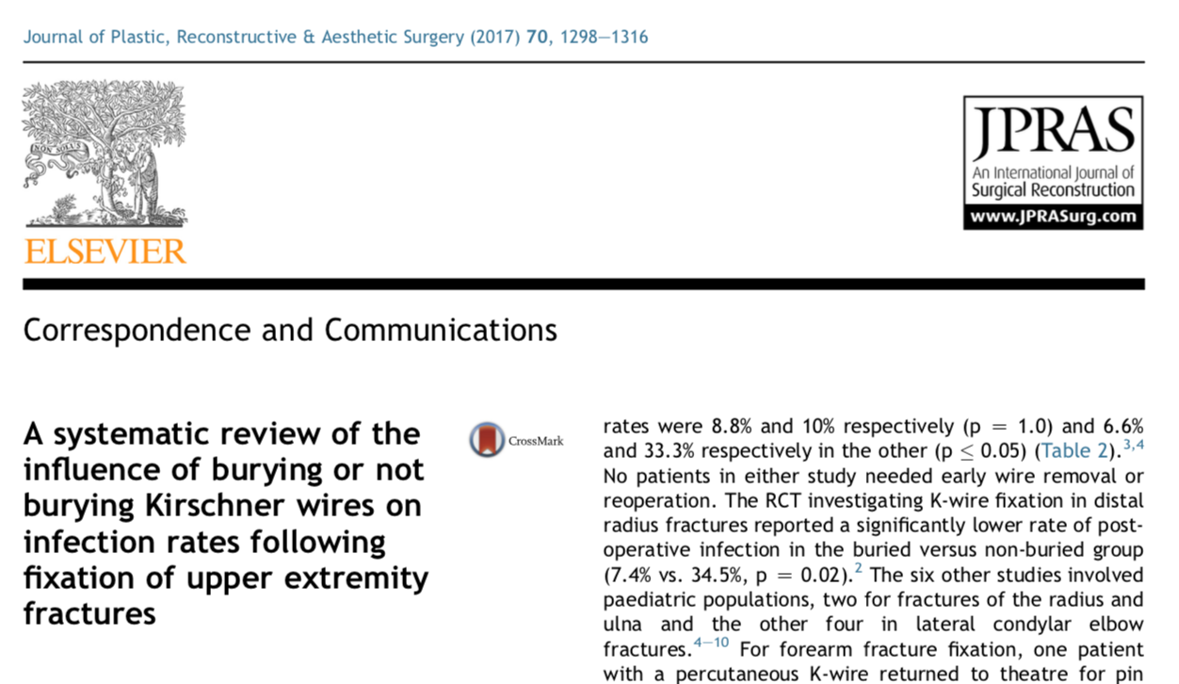
Poor evidence informing buried vs exposed K-wires
Systematic review
Buried vs exposed wires in upper limb – limited evidence
Higher rate of infection in exposed
Further research needed in hand

Slide 4
Bury vs. exposed: clinician preferences
Key areas of clinical variability and uncertainty
Bury or leave K-wires exposed based on surgical dogma
Support for definitive RCT in hand fractures
Prospective data collection for RCT work-up

Slide 5
WIRE SE: AIM
To assess the current use of Kirschner wires for fixing metacarpal or phalangeal fractures in adults

Slide 6
WIRE SE: DESIGN
Multi-centre, prospective data collection using REDCap
Inclusion:
Adults with acute phalangeal or metacarpal fracture(s) managed with K-wire(s)
Exclusion:
Children (< 18 years)
Carpal bone fractures
Elective operations

Slide 7
WIRE SE: GET INVOLVED
Gain support of local department (Clinical Lead and consultant body)
Build a team of collaborators (one consultant and 1-2 trainees)
Register the study with relevant local authority (e.g. R&D dept)
Access REDCap and start prospective data collection

Slide 8
WIRE SE: GET OUTPUT
Need to achieve complete data sets for 10 or more patients
Consultant collaborator to ensure completeness of data
Data required within study protocol
Successful collaborators will be part of PubMed cited on publication
Certificate of participation for portfolio
Named and acknowledged on national/international presentations
Less than 10 complete data sets will be acknowledged only

Slide 9
Further information
Search: “WIRE RSTN”
Contact: wiretrial@gmail.com
WIRE Study References
WIRE Research Collaborative. Buried versus exposed Kirschner wires following fixation of metacarpal and phalangeal fractures: a national clinician and patient survey. Plast Reconstruc Surg Global Open 2018; 6(4):e1747.
Wormald JCR, Jain A, Lloyd-Hughes H, Gardiner S, Gardiner MD. A systematic review of the influence of burying or not burying Kirschner wires on infection rates following fixation of upper extremity fractures. J Plast Reconstr Aesthet Surg. 2017 Sep;70(9):1298-1301. doi: 10.1016/j.bjps.2017.06.036. PMID: 28712881

